Slide 1
Data Engineering Module 3
Kerry Nakayama

Slide 2
Execution Plans

Slide 3
Explain

Slide 4
Execution Plans

Slide 5
Analyze Plans

Slide 6
Seeks vs Scans

Slide 7
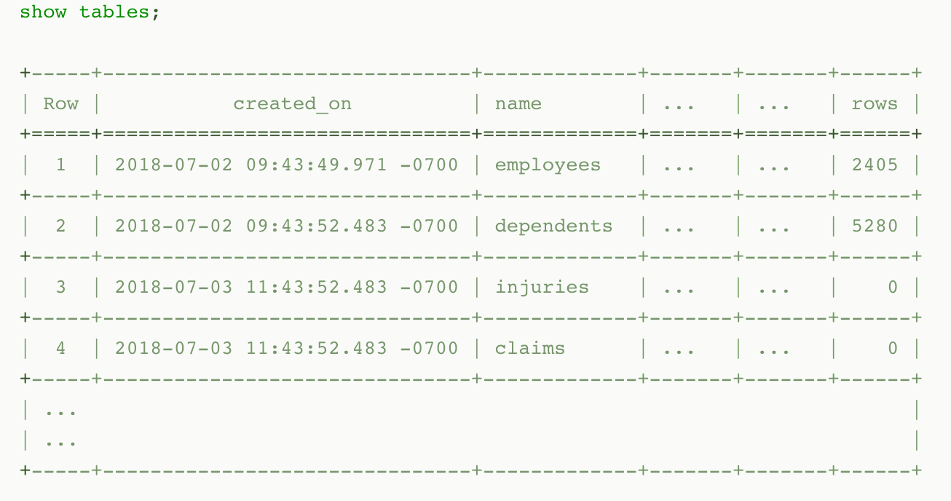
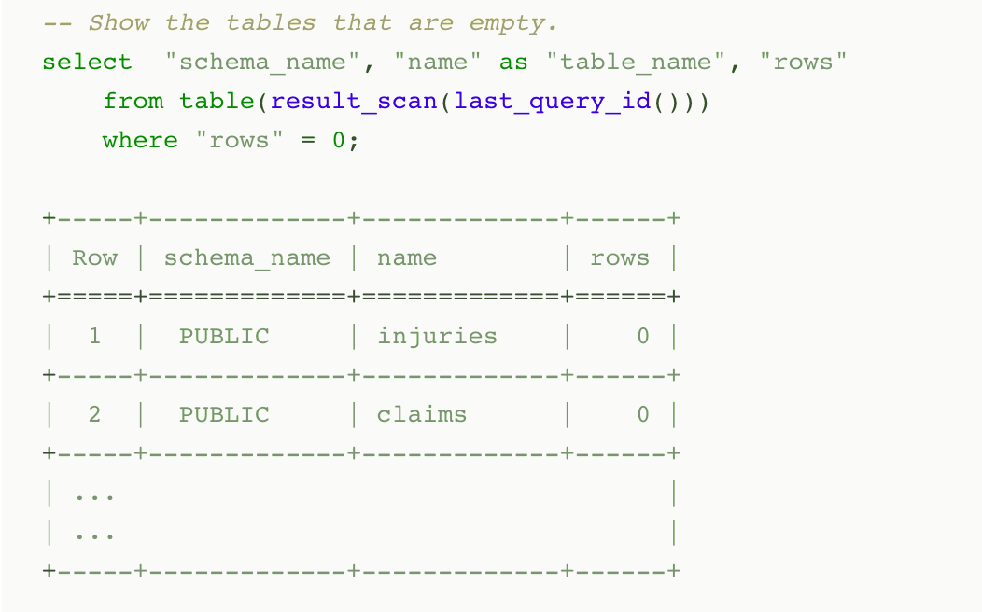
Persisted Query Results
When a query is executed, the result is persisted (i.e. cached) for a period (currently 24 hours). At the end of the time period, the result is purged from the system
Snowflake uses persisted query results to avoid re-generating results when nothing has changed
you can perform further processing on the result of a query that you’ve already run
Notes:
Typically, query results are reused if all of the following conditions are met:
The new query syntactically matches the previously-executed query.
The table data contributing to the query result has not changed.
The persisted result for the previous query is still available.
The role accessing the cached results has the required privileges If the query was a SELECT query, the role executing the query must have the necessary access privileges for all the tables used in the cached query.If the query was a SHOW query, the role executing the query must match the role that generated the cached results.
Any configuration options that affect how the result was produced have not changed.
The query does not include functions that must be evaluated at execution time, e.g. CURRENT_TIMESTAMP and UUID_STRING. (Note that the the CURRENT_DATE() function is an exception to this rule; even though CURRENT_DATE() is evaluated at execution time, queries that use CURRENT_DATE() can still use the query reuse feature.)
The table’s micro-partitions have not changed (e.g. been reclustered or consolidated) due to changes to other data in the table.

Slide 8
Estimating Approximate Values
Estimating Values
Snowflake uses the Space-Saving algorithm, a space and time efficient way of estimating approximate frequent values in data sets
Snowflake uses the t-Digest algorithm, a space and time efficient way of estimating approximate percentile values in data sets.

Slide 9
Estimating with HyperLogLog (HLL)
HyperLogLog is used to estimate the approximate number of distinct values in a data set
HLL can be used in place of COUNT(DISTINCT …) in situations where estimating cardinality is acceptable
HLL Returns an approximate distinct cardinality of the input
HLL_ACCUMULATE Skips the final estimation step and returns the HLL state at the end of an aggregation.
HLL_COMBINE Combines (i.e. merges) input states into a single output state
HLL_ESTIMATE Computes a cardinality estimate of a HLL state produced by HLL_ACCUMULATE and HLL_COMBINE
HLL_EXPORT Converts HLL states from BINARY format to an OBJECT (which can then be printed and exported as JSON).
HLL_IMPORT Converts HLL states from OBJECT format to BINARY format
Notes:
HyperLogLog implementation is 1.62338% (i.e. the average relative difference to the corresponding COUNT(DISTINCT …)

Slide 10

Query Profile to Analyze Queries
Query Profile
QP is a powerful tool for understanding the mechanics of queries
It can be used whenever you want or need to know more about the performance or behavior of a particular query
It is designed to help you spot typical mistakes in SQL query expressions to identify potential performance bottlenecks and improvement opportunities
Data Processing Operators
Filter
Join
Aggregate
Grouping Sets
Window Function
Sort / Sort with Limit
Flatten
Join Filter
Union All
Data Access and Generation Operators
Table Scan
Values Clause
Generator
External Scan
Internal Object
DML Operators
Insert
Delete
Update
Merge
Unload
Notes:
TableScan Represents access to a single table. Attributes:
Full table name — the name of the accessed table, including database and schema.
Columns — list of scanned columns
Table alias — used table alias, if present
Extracted Variant paths — list of paths extracted from VARIANT columns
ValuesClause List of values provided with the VALUES clause. Attributes:
Number of values — the number of produced values.
Values — the list of produced values.
Generator Generates records using the TABLE(GENERATOR(...)) construct. Attributes:
rowCount — provided rowCount parameter.
timeLimit — provided timeLimit parameter.
ExternalScan Represents access to data stored in stage objects. Can be a part of queries that scan data from stages directly, but also for data-loading COPY queries. Attributes:
Stage name — the name of the stage where the data is read from.
Stage type — the type of the stage (e.g. TABLE STAGE).
InternalObject Represents access to an internal data object (e.g. an Information Schema table or the result of a previous query). Attributes:
Object Name — the name or type of the accessed object.
Data Processing Operators
Filter Represents an operation that filters the records. Attributes:
Filter condition - the condition used to perform filtering.
Join Combines two inputs on a given condition. Attributes:
Join Type — Type of join (e.g. INNER, LEFT OUTER, etc.).
Equality Join Condition — for joins which use equality-based conditions, it lists the expressions used for joining elements.
Additional Join Condition — some joins use conditions containing non-equality based predicates. They are listed here.
Aggregate Groups input and computes aggregate functions. Can represent SQL constructs such as GROUP BY, as well as SELECT DISTINCT. Attributes:
Grouping Keys — if GROUP BY is used, this lists the expressions we group by.
Aggregate Functions — list of functions computed for each aggregate group, e.g. SUM.
GroupingSets Represents constructs such as GROUPING SETS, ROLLUP and CUBE. Attributes:
Grouping Key Sets — list of grouping sets
Aggregate Functions — list of functions computed for each group, e.g. SUM.
WindowFunction Computes window functions. Attributes:
Window Functions — list of window functions computed.
Sort Orders input on a given expression. Attributes:
Sort keys — expression defining the sorting order.
SortWithLimit Produces a part of the input sequence after sorting, typically a result of an ORDER BY ... LIMIT ... OFFSET ... construct in SQL. Attributes:
Sort keys — expression defining the sorting order.
Number of rows — number of rows produced.
Offset — position in the ordered sequence from which produced tuples are emitted.
Flatten Processes VARIANT records, possibly flattening them on a specified path. Attributes:
input — the input expression used to flatten the data.
JoinFilter Special filtering operation that removes tuples that can be identified as not possibly matching the condition of a Join further in the query plan. Attributes:
Original join ID — the join used to identify tuples that can be filtered out.
UnionAll Concatenates two inputs. Attributes: none.
DML Operators
Insert Adds records to a table either through an INSERT or COPY operation. Attributes:
Input expressions — which expressions are inserted.
Table names — names of tables that records are added to.
Delete Removes records from a table. Attributes:
Table name — the name of the table that records are deleted from.
Update Updates records in a table. Attributes:
Table name — the name of the updated table.
Merge Performs a MERGE operation on a table. Attributes:
Full table name — the name of the updated table.
Unload Represents a COPY operation that exports data from a table into a file in a stage. Attributes:
Location - the name of the stage where the data is saved.

Slide 11
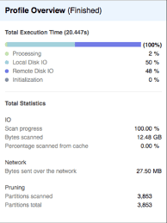
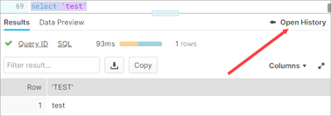
Query Profile
Powerful tool for understanding the mechanics of queries
Identify potential performance bottlenecks
Available through the web interface
Provides a graphical representation of the main components of processing plan for the query
Provides statistics and details of the overall query
Notes:
We will circle back to this later today but good to take a look at it now

Slide 12
Query Profile

Slide 13
Break & Lab1
Notes:
Let’s look at a query and I want you all to break into groups and optimize it and fix any errors

Slide 14
SQL SELECT

Slide 15
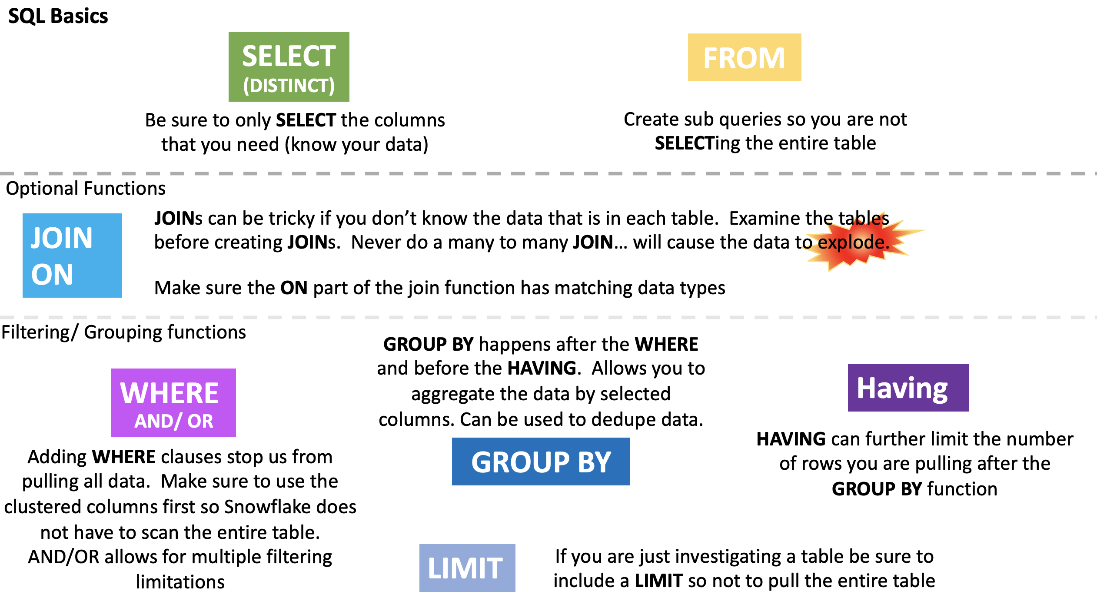
Snowflake Automation
Dynamic query optimization:
Ensures that Snowflake operates as efficiently as possible by looking at the state of the system when a query is dispatched for execution,
Looks at it multiple times – not just when it is compiled
USE THE SQL THAT YOU ALREADY KNOW
Rather than dealing with NOSQL and the like you can use SQL that your team is already familiar with to create dynamic, powerful, fast moving queries.

Slide 17
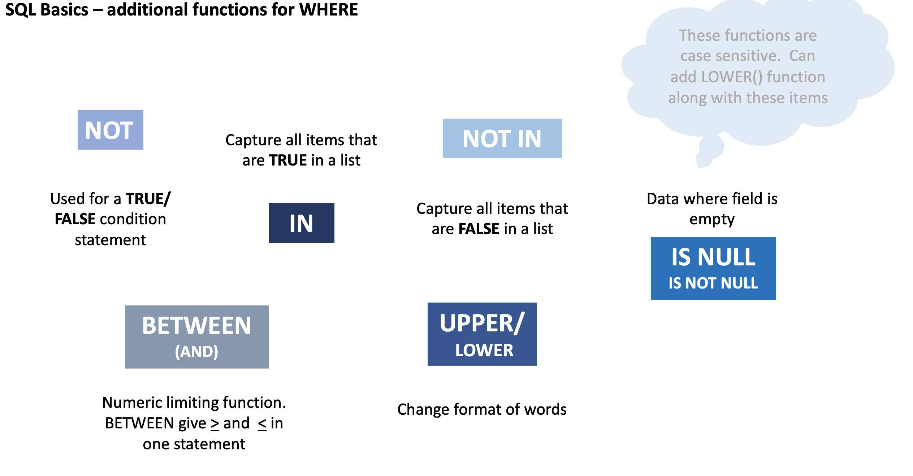

Slide 18
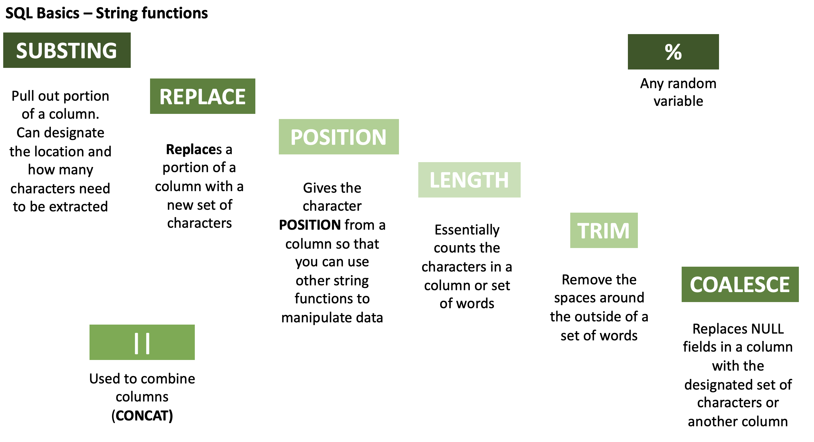

Slide 19
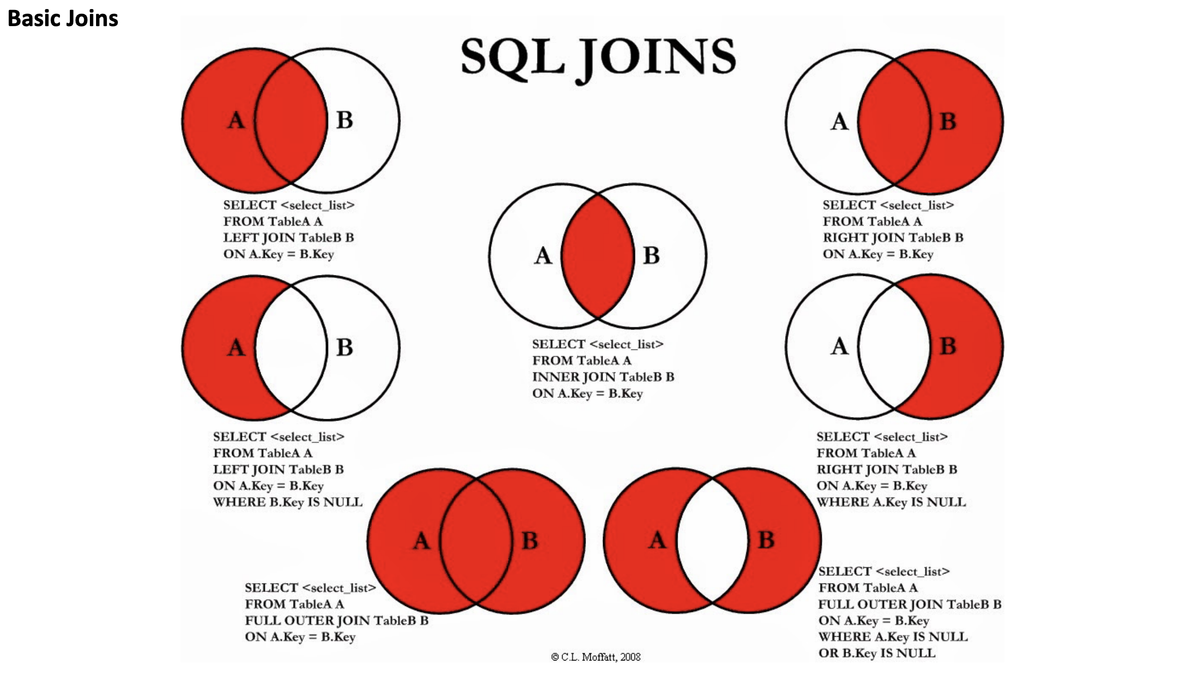

Slide 20


Hierarchy of SQL Functions
Mini Lab Breakout SELECT Statement Execution Order
SELECT DISTINCT <TOP_specification> <select_list>
FROM
(SELECT <select_list>
FROM <left_table> <join_type>
JOIN <right_table>
ON <join_condition> ) X
WHERE <where_condition>
GROUP BY <group_by_list>
HAVING <having_condition>
ORDER BY <order_by_list>
Notes:
FROM clause
ON clause
OUTER clause
WHERE clause
GROUP BY clause
HAVING clause
SELECT clause
DISTINCT clause
ORDER BY clause
TOP clause
Tips & Cautions
Aliases created in the SELECT list cannot be used by earlier steps.
This restriction is imposed because the column value may not yet have been determined when the clauses that appear before the SELECT clause are evaluated (such as the WHERE clause).
In some databases (such as MySQL), using aliases created in the SELECT list is allowed in GROUP BY and HAVING clause,
even though these clauses appear before (and are evaluated earlier than) the SELECT clause.
Expression aliases cannot be used by other expressions within the same SELECT list.
This is because the logical order in which the expressions are evaluated does not matter and is not guaranteed.
For example, this SELECT clause might not work as expected, and is therefore, not supported: SELECT a + 1 AS x, x + 1 AS y
When using an INNER JOIN, it doesn’t matter if you specify your logical expressions in the WHERE clause or the ON clause.
This is true because there's no logical difference between the ON and WHERE (except for when using an OUTER JOIN or GROUP BY ALL option).
The DISTINCT clause is redundant when GROUP BY is used.
Therefore, it would not remove any rows from the recordset.

Slide 21


Subqueries
Correlated vs Uncorrelated
Correlated refers to one or more columns from outside of the subquery
Uncorrelated has no such external column references. It is an independent query
Scalar vs Non-Scalar
Scalar subquery returns a single value (one column of one row)
Non-Scalar subquery returns 0 to multiple rows, each of which may contain 1 to multiple columns
SELECT p.name, p.annual_wage, p.country
FROM pay as p WHERE p.annual_wage <
(SELECT max(per_capita_gdp) FROM international_gdp i WHERE p.country = i.name);
SELECT c1, c2 FROM table1
WHERE c1 =
(SELECT max(x) FROM table2);
SELECT p.name, p.annual_wage, p.country FROM pay as p WHERE p.annual_wage < (SELECT per_capita_gdp FROM international_gdp WHERE name = 'Brazil');
Notes:
-- Uncorrelated subquery: select c1, c2 from table1 where c1 = (select max(x) from table2); -- Correlated subquery: select c1, c2 from table1 where c1 = (select x from table2 where y = table1.c2);
uncorrelated subquery in a where clause. The subquery gets the per capita GDP of Brazil, and the outer query selects all the jobs (in any country) that pay less than the per-capita GDP of Brazil.
The subquery is uncorrelated because the value that it returns does not depend upon any column of the outer query.
The subquery only needs to be called once during the entire execution of the outer query.
Uncorrelated - select p.name, p.annual_wage, p.country from pay as p where p.annual_wage < (select per_capita_gdp from international_gdp where name = 'Brazil’);
correlated subquery in a where clause. The query lists jobs where the annual pay of the job is less than the per-capita GDP in that country.
This subquery is correlated because it is called once for each row in the outer query and is passed a value, p.country (country name), from the row.
Correlated sub query - select p.name, p.annual_wage, p.country from pay as p where p.annual_wage < (select max(per_capita_gdp) from international_gdp i where p.country = i.name);

Slide 22
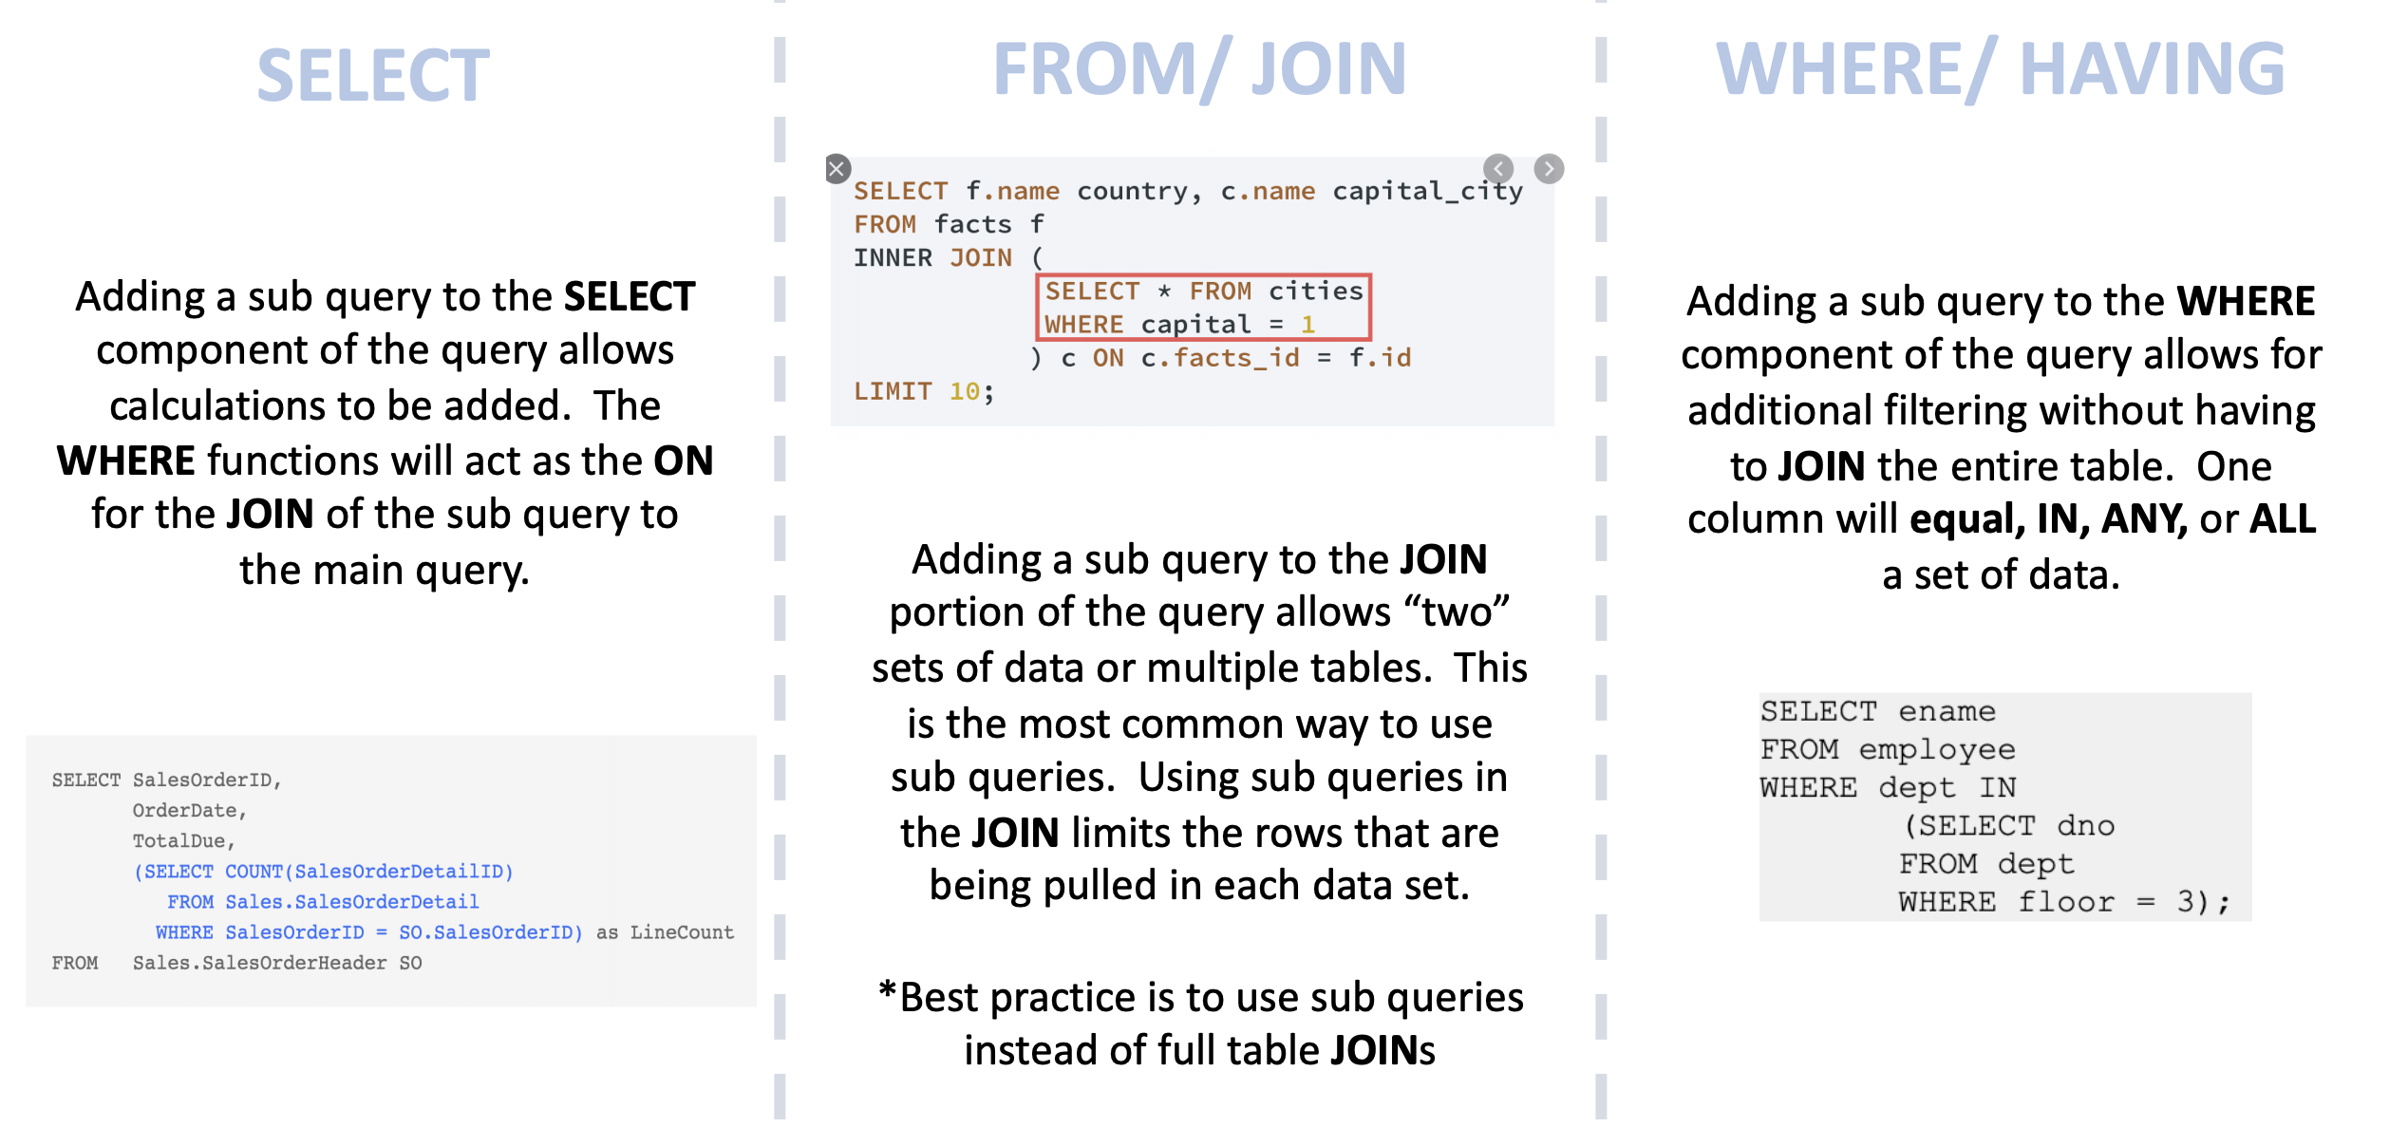
Subqueries – Where can they be used
Notes:
Where can you put subqueries ( use slide I created for SQL class)
Subquery operators operate on nested query expressions. They can be used to compute values that are:
Returned in a SELECT list.
Grouped in a GROUP BY clause.
Compared with other expressions in the WHERE or HAVING clause
Limitations
Although subqueries can contain a wide range of SELECT statements, they have the following limitations:
Some clauses are not allowed inside of ANY/ALL/NOT EXISTS subqueries.
The only type of subquery that allows a LIMIT / FETCH clause is an uncorrelated scalar subquery. Also, because an uncorrelated scalar subquery returns only 1 row, the LIMIT clause has little or no practical value inside a subquery.

Slide 23

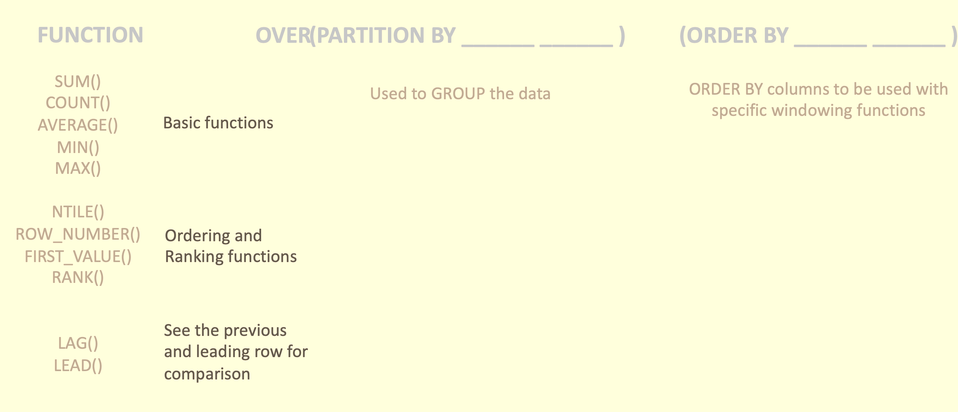

Windowing functions
Window functions operate on groups of rows that are related (e.g. by date or location). Snowflake supports:
General window functions.
Window functions that calculate rank (e.g. highest, second-highest, etc.)
Window functions that support cumulative window frames and sliding window frames
... OVER ( [ PARTITION BY <expr1> ] [ ORDER BY <expr2> [ { cumulativeFrame | slidingFrame } ] ] ) ...

Slide 24
More stuff on windowing functions

Slide 25
More Advanced querying
Querying semi structured data
Arrays allow data to be stored that is not used regularly
Arrays can be flattened if it needs to be accessed
Example of an array:
Using Sequences
Sequences are used to generate unique numbers across sessions and statements, including concurrent statements.
They can be used to generate values for a primary key or any column that requires a unique value
select vm.value:make::string as make, vm.value:model::string as model, ve.value::string as "Extras Purchased" from car_sales , lateral flatten(input => src:vehicle) vm , lateral flatten(input => vm.value:extras) ve;
"vehicle" : [ {"make": "Toyota", "model": "Camry", "year": "2017", "price": "23500", "extras":["ext warranty", "rust proofing", "fabric protection"]}
Notes:
Example of an array "vehicle" : [ {"make": "Toyota", "model": "Camry", "year": "2017", "price": "23500", "extras":["ext warranty", "rust proofing", "fabric protection"]}
Snowflake sequences currently utilize the following semantics:
All values generated by a sequence are globally unique as long as the sign of the sequence interval does not change. Concurrent queries never observe the same value, and values within a single query are always distinct.

Slide 26
REGEX

Slide 27
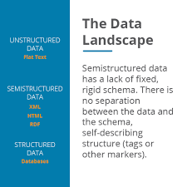
Snowflake Data Types
Snowflake offers native ingestion of various data types that other data warehouses don’t.
Have any of you ever been in a scenario where you needed to load, say, an XML or a multi-dimensional JSON into a structured SQL database?
How did you have to manipulate that data?
How much work did it take to get it in there?
Did you have to flatten it first?
The makers of snowflake felt your pain here and offer the VARIANT data type.

Slide 28
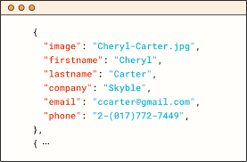
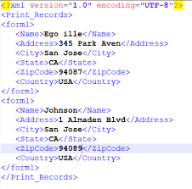
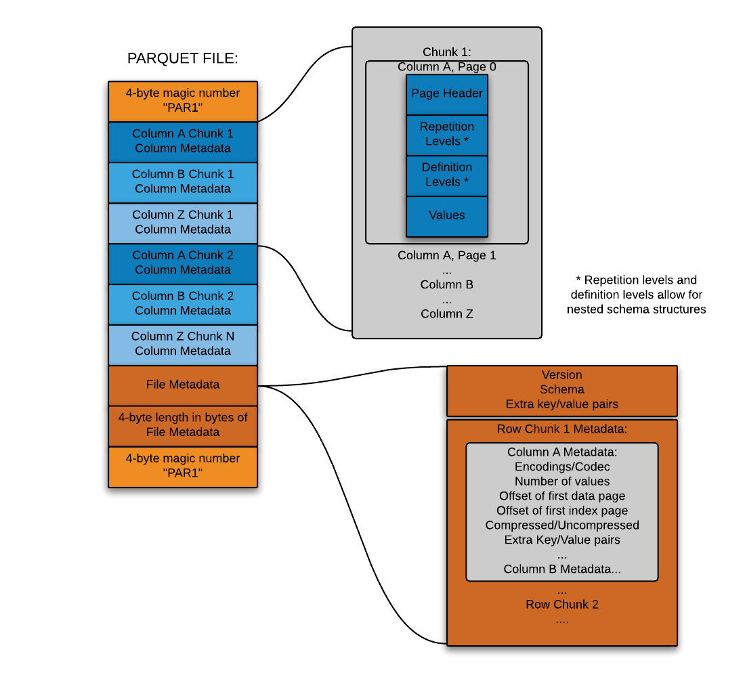
Snowflake data types
Snowflake started by making it possible to flexibly store semi-structured records inside a relational table in native form
This is accomplished through a custom datatype (Snowflake’s VARIANT datatype) that allows schema-less storage of hierarchical data, including JSON, Avro, XML and Parquet
This makes it possible to load semi-structured data directly into Snowflake without pre-processing, losing information, or defining a schema
You simply create a table containing a column with Snowflake’s VARIANT datatype and then load files containing semi-structured data into that table.
JSON
Avro
XML
Parquet

Slide 29
Flattening Arrays

Slide 30
Break & Lab2

Slide 31
Updating Tables

Slide 32
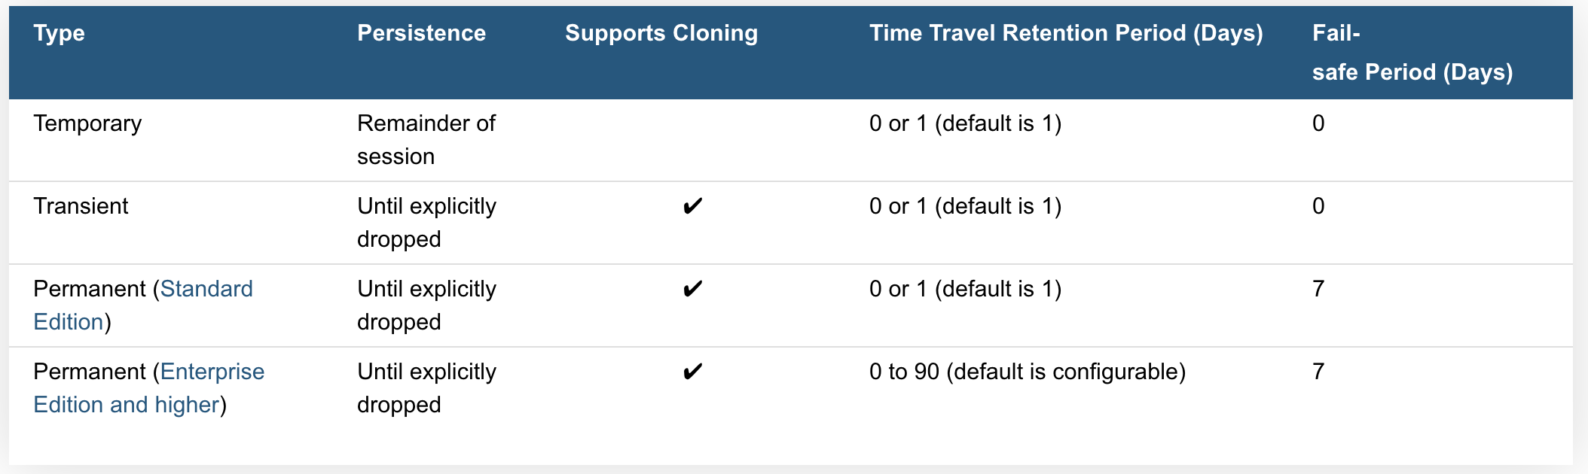
Working with Temp tables and Transient tables
Temporary Tables only exist within the session in which they were created. Once the session ends, data stored in the table is purged completely from the system
Transient Tables persist until explicitly dropped and are available to all users with the appropriate privileges. Transient tables are like permanent tables with the key difference that they do not have a Fail-safe period.
Notes:
Temp tables
transitory data (e.g. ETL data, session-specific data)
they are not visible to other users or sessions and do not support some standard features such as cloning.
is not recoverable, either by the user who created the table or Snowflake.
the data stored in the table contributes to the overall storage charges that Snowflake bills your account
Transient Tables
transient tables are specifically designed for transitory data that needs to be maintained beyond each session (in contrast to temporary tables), but does not need the same level of data protection and recovery provided by permanent tables.
Transient Databases and Schemas
Snowflake also supports creating transient databases and schemas. All tables created in a transient schema, as well as all schemas created in a transient database, are transient by definition.
Time Travel Notes
The Time Travel retention period for a table can be specified when the table is created or any time afterwards. Within the retention period, all Time Travel operations can be performed on data in the table (e.g. queries) and the table itself (e.g. cloning and restoration).
Temporary tables can have a Time Travel retention period of 1 day; however, a temporary table is purged once the session (in which the table was created) ends so the actual retention period is for 24 hours or the remainder of the session, whichever is shorter.
Fail-safe Notes
The Fail-safe period is not configurable for any table type.
Transient and temporary tables have no Fail-safe period. As a result, no additional data storage charges are incurred beyond the Time Travel retention period.

Slide 33
Working with Temp tables and Transient tables
Creating Temporary Tables simply specify the TEMPORARY keyword (or TEMP abbreviation) in CREATE TABLE
Creating Transient Tables, schemas, or databases are done by simply specifying the TRANSIENT keyword when creating the object:
create temporary table mytemptable (id number, creation_date date);
create transient table mytranstable (id number, creation_date date);
After creation, temporary and transient tables cannot be converted to any other table type
Notes:
transitory data (e.g. ETL data, session-specific data)
they are not visible to other users or sessions and do not support some standard features such as cloning.
is not recoverable, either by the user who created the table or Snowflake.
the data stored in the table contributes to the overall storage charges that Snowflake bills your account

Slide 34
Non-Materialized Views vs Materialized Views
Views usually refer to Non-Materialized Views
basically a named definition of a query
results are not stored for future use
Materialized views are named as though it were a type of view
Behave more like a table
Results are stored
Works well with unchanged base tables
Optimizes external tables
View has less rows than base table or
calculated field
CREATE [ OR REPLACE ] [ SECURE ]
MATERIALIZED VIEW [ IF NOT EXISTS ] <name> [ COPY GRANTS ] ( <column_list> ) [ COMMENT = '<string_literal>' ] [ CLUSTER BY ( <expr1> [, <expr2>
... ] ) ] AS <select_statement>
Notes:
Non materialized view
Selecting some (or all) columns in a table.
Selecting a specific range of data in table columns.
Joining data from two or more tables
Materialized views are designed to improve query performance for workloads composed of common, repeated query patterns. However, materializing intermediate results incurs additional costs. As such, before creating any materialized views, you should consider whether the costs are offset by the savings from re-using these results frequently enough.
Query results contain a small number of rows and/or columns relative to the base table (the table on which the view is defined).
Query results contain results that require significant processing, including:
Analysis of semi-structured data.
Aggregates that take a long time to calculate.
The query is on an external table (i.e. data sets stored in files in an external stage), which might have slower performance compared to querying native database tables.

Slide 35


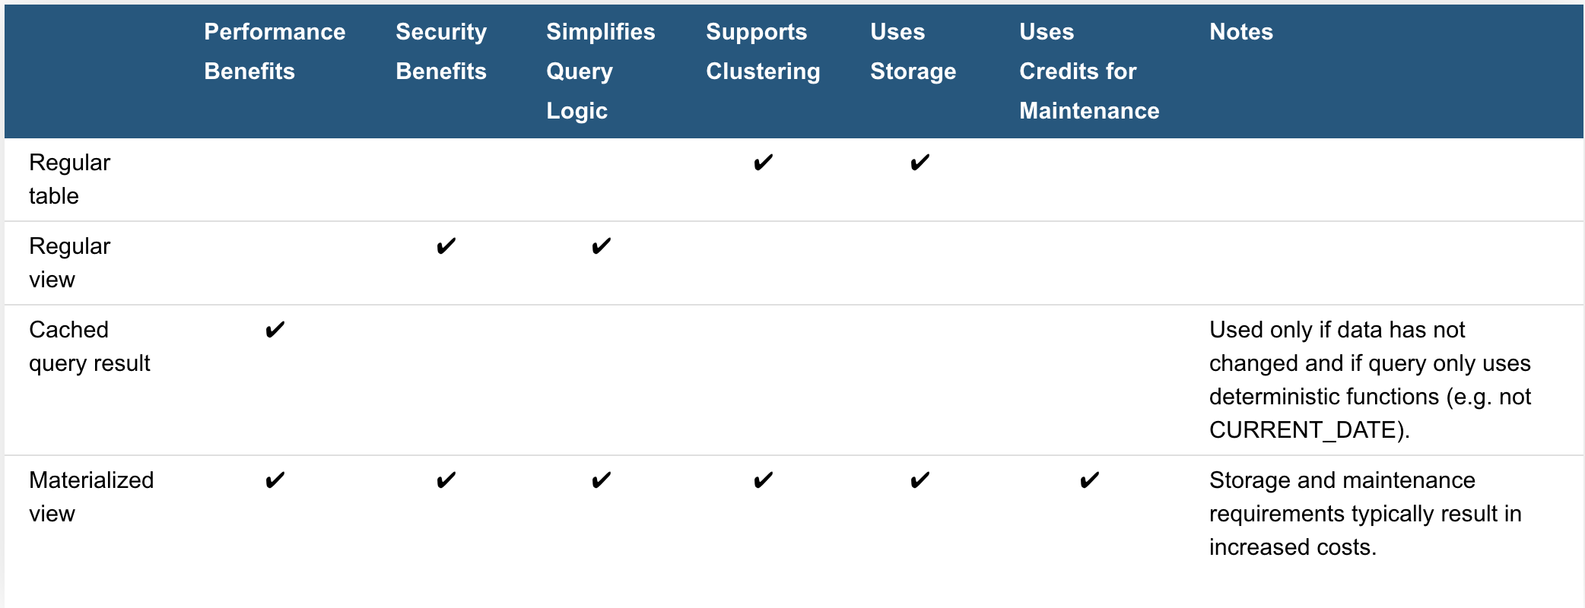
Advantages of Views
Secured views provide improved data privacy and data sharing
Both non-materialized and materialized views can be defined as secure
Views enable writing more modular code
Views allow you to grant access to just a portion of the data in a table(s)
Provide privileges based on data in each view
Views can improve performance
Notes:
Two use cases of modular code
suppose that your hospital database has a table listing information about all employees.
You can create views to make it convenient to extract information about only the medical staff or only the maintenance staff. You can even create hierarchies of views.
rather than writing one large and difficult-to-understand query, you can decompose the query into smaller pieces, and create a view for each of those pieces
Limitations on Views
The definition for a view cannot be updated (i.e. you cannot use ALTER VIEW or ALTER MATERIALIZED VIEW to change the definition of a view). To change a view definition, you must recreate the view with the new definition.
Changes to a table are not automatically propagated to views created on that table. For example, if you drop a column in a table, the views on that table might become invalid.
Views are read-only (i.e. you cannot execute DML commands directly on a view). However, you can use a view in a subquery within a DML statement that updates the underlying base table

Slide 36




Table Design Considerations
Date/Time Data Types for Columns
Use a date and timestamp value rather than a varchar
Referential Integrity Constraints
Other than not null are added but do not actually do anything in Snowflake
When to Set a Clustering Key
Loaded data does not match how it is queried
Query Profile shows excessive table scan time
Notes:
Date and time
When defining columns to contain dates or timestamps, we recommend choosing a date or timestamp data type rather than a character data type. Snowflake stores DATE and TIMESTAMP data more efficiently than VARCHAR, resulting in better query performance
Referential integrity constraints
in Snowflake are informational and, with the exception of NOT NULL, not enforced. Constraints other than NOT NULL are created as disabled.
However, constraints provide valuable metadata. The primary keys and foreign keys enable members of your project team to orient themselves to the schema design and familiarize themselves with how the tables relate with one another.
When to add a clustering key
The order in which the data is loaded does not match the dimension by which it is most commonly queried (e.g. the data is loaded by date, but reports filter the data by ID). If your existing scripts or reports query the data by both date and ID (and potentially a third or fourth column), you may see some performance improvement by creating a multi-column clustering key.
Query Profile indicates that a significant percentage of the total duration time for typical queries against the table is spent scanning. This applies to queries that filter on one or more specific columns.

Slide 37

Table Design Considerations continued
When to Specify Column Lengths
When it is predictable otherwise Snowflake automatically optimizes it
Storing Semi-structured Data in a VARIANT Column vs. Flattening the Nested Structure
It is better to flatten objects if it is known how you will be using the columns
Converting a Permanent Table to a Transient Table or Vice-Versa
It is impossible to change a permanent table to a transient
It can be cloned
Notes:
Column size
Snowflake compresses column data effectively; therefore, creating columns larger than necessary has minimal impact on the size of data tables. Likewise, there is no query performance difference between a column with a maximum length declaration (e.g. VARCHAR(16777216)), and a smaller precision.
column data is predictable, define an appropriate column length
Data loading operations are more likely to detect issues such as columns loaded out of order
Unspecified lengths cause some third-party tools may anticipate consuming the maximum size value, which can translate into increased client-side memory usage or unusual behavior.
For better pruning and less storage consumption, we recommend flattening your object and key data into separate relational columns if your semi-structured data includes:
Dates and timestamps, especially non-ISO 8601 dates and timestamps, as string values
Numbers within strings
Arrays
Currently, it isn’t possible to change a permanent table to a transient table using the ALTER TABLE command. The TRANSIENT property is set at table creation and cannot be modified.
Similarly, it isn’t possible to directly change a transient table to a permanent table.
To convert an existing permanent table to a transient table (or vice versa) while preserving data and other characteristics such as column defaults and granted privileges, you can create a new table and use the COPY GRANTS clause, then copy the data:

Slide 38
Null Handeling

Slide 39
COALESCE Functions

Slide 40
Timemachine

Slide 41
Fail Safe

Slide 42
Deletion Consideration

Slide 43
Table Interpolation

Slide 44


Snowflake Automation
So now let’s talk about a lot of the “under the hood” things that Snowflake can do for us, including:
Time Travel:
Enables you to immediately revert any table, database or schema to a previous state. It’s enabled automatically and stores data as it’s transformed for up to 24 hours, or 90 days in enterprise versions.
Copying to clone:
Most data warehouses require you to copy data to clone, forcing a large amount of manual effort and a significant time investment.
Snowflake’s multi-cluster, shared data architecture ensures that you never need to copy any data, because any warehouse or database automatically references the same centralized data store

Slide 45
Break & Lab3
Notes:
Focus on ETL work

Slide 46
Efficiency in Multi-Table Queries

Slide 47
Subqueries – Review
Notes:
Where can you put subqueries ( use slide I created for SQL class)
Subquery operators operate on nested query expressions. They can be used to compute values that are:
Returned in a SELECT list.
Grouped in a GROUP BY clause.
Compared with other expressions in the WHERE or HAVING clause
Limitations
Although subqueries can contain a wide range of SELECT statements, they have the following limitations:
Some clauses are not allowed inside of ANY/ALL/NOT EXISTS subqueries.
The only type of subquery that allows a LIMIT / FETCH clause is an uncorrelated scalar subquery. Also, because an uncorrelated scalar subquery returns only 1 row, the LIMIT clause has little or no practical value inside a subquery.

Slide 48

Common Table Expressions (CTE)s
A CTE (common table expression) is a named subquery defined in a WITH clause
think of the CTE as a temporary view
Non-Recursive – CTE does not reference itself
Will need two-level join for hierarchal data
Recursive - CTE that references itself
Think self joins on hierarchal data
Can create multiple joins without know how many levels are left
select emps.title, emps.employee_id, mgrs.employee_id as manager_id, mgrs.title as "MANAGER TITLE"
from employees as emps
left outer join employees as mgrs
on emps.manager_id = mgrs.employee_id
order by mgrs.employee_id nulls first,
emps.employee_id;
WITH [ RECURSIVE ] <cte_name>
AS
( <anchor_clause>
UNION ALL
<recursive_clause> )
SELECT ... FROM ...;
Notes:
Recursive CTE Considerations
Potential for Infinite Loops
In theory, constructing a recursive CTE incorrectly can cause an infinite loop. In practice, Snowflake prevents this by limiting the number of iterations that the recursive clause will perform in a single query. The MAX_RECURSIONS parameter limits the number of iterations.
To change MAX_RECURSIONS for your account, please contact Snowflake Support.
More Hierarchal data
In a two-level hierarchy (for example, managers and employees), the data can be queried with a two-way join
In a three-level hierarchy, you can use a 3-way join:
This concept can be extended to as many levels as needed, as long as you know how many levels are needed. But if the number of levels changes, the queries need to change.
Can also use connect by along with recursive CTEs

Slide 49
Common Table Expressions (CTE)s

Slide 50
Common Table Expressions (CTE)s

Slide 51
Common Table Expressions (CTE)s

Slide 52
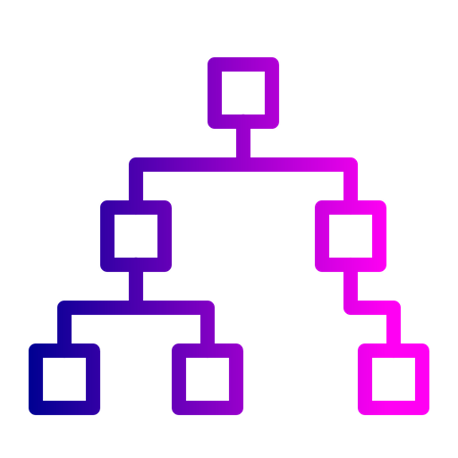
Hierarchal Data - Recursive CTE example
-- This is the WITH clause, of course.
with recursive managers
-- Column names for the "view"/CTE
(indent, employee_id, manager_id, employee_title)
as
-- Common Table Expression
( -- Anchor Clause
select '' as indent, employee_id, manager_id, title as employee_title
from employees
where title = 'President’
union all
-- Recursive Clause
select indent || '--- ‘,
employees.employee_id, employees.manager_id, employees.title
from employees
join managers
on employees.manager_id = managers.employee_id ) -- This is the "main select".
select indent || employee_title as title, employee_id, manager_id
from managers ;

Slide 53

Confused? ASK QUESTIONS

Slide 54
Break & Lab4
Notes:
Setting up a recursive CTE

